Slide 1
Synthetic satellite imagery from ACCESS NWP forecasts
Lawrie Rikus and Zhian Sun,
Earth System Modelling
Bureau Research and Development
23 March 2016
Notes:
1

Slide 2
Introduction
Scheme initially designed for model evaluation
Direct comparison of model with satellite data
Test for radiative transfer and cloud fields
This is a model-to-satellite scheme (as opposed to satellite-to-product)
Geostationary satellite data is perfect for regional scale NWP
large scale
Compatible with regional models
Numbers of pixels per grid square is (usually) large
available at least hourly
Ties in with forecast output
Synthetic imagery is a readily accessible summary of the model state
Forecasters trained to evaluate satellite imagery can apply same techniques to the model forecast imagery – synthetic imagery.
Time to return to the original purpose
APS1 models stable for a couple of years
Years of hourly data
Data mining, image analysis technology has evolved to be highly applicable (and as python tools)
Himawari 8 data an order of magnitude more useful
10 minute, higher spatial resolution
More useful channels

Slide 3
The model-to-satellite paradigm
Uses model's own radiative transfer scheme (or similar physically based code)
All the required fields are available
Tests model prognostic cloud fields – position, height, fraction
Tests cloud optical property parameterization
Tests radiative transfer assumptions – cloud overlap
Tests model surface properties
Applied to every operational forecast every day
Different model resolutions
Sample a huge range of synoptic situations

Slide 4
The synthetic imagery code
Solves RT equation using parameterization-type code
Same physical assumptions as RT in the model
Takes account of spectral resolution function of specific satellite channel
Initial code based on Fels-Schwarzkopf parameterization in legacy models.
Simple band cooling-to-space emissivity approach
Spectral response simply folded in by band multiplcation
Easy to add new satellite channels
Restricted to emission channels
Different formalism to UM so difficult to add in cloud assumptions
SES version added by Zhian Sun
Same physics as UM
Easy to add in UM cloud property treatments
Requires spectral function to be pre-folded into band coefficients
Model cloud scattering handled accurately
Notes:
4

Slide 5
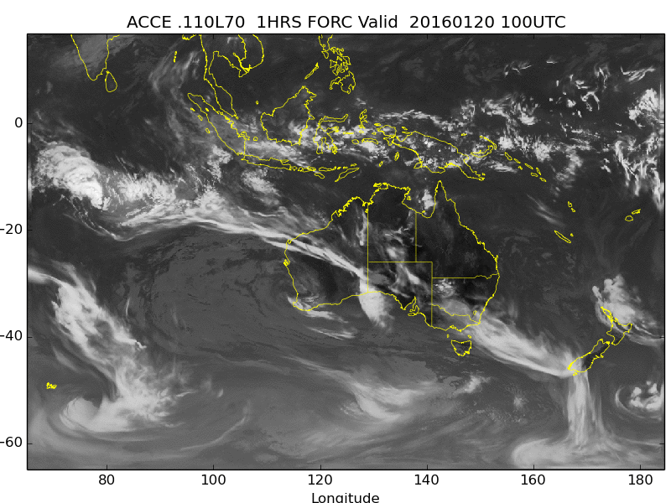
ACCESS R: IR1 Channel
8 Days X Hourly forecasts (1 – 23 hours)

Slide 6
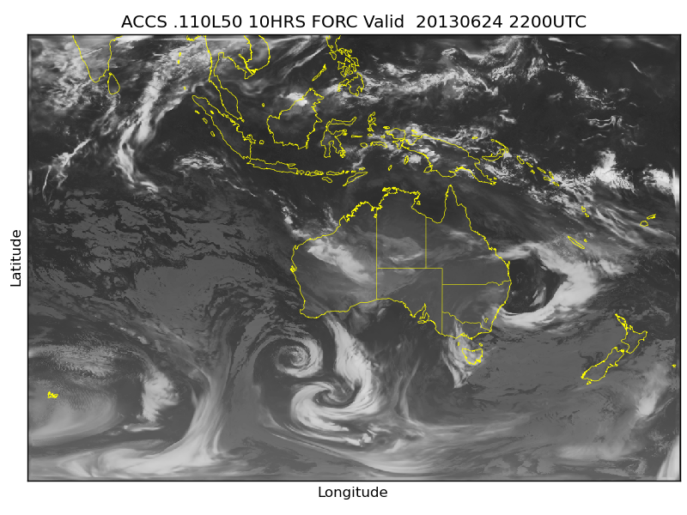
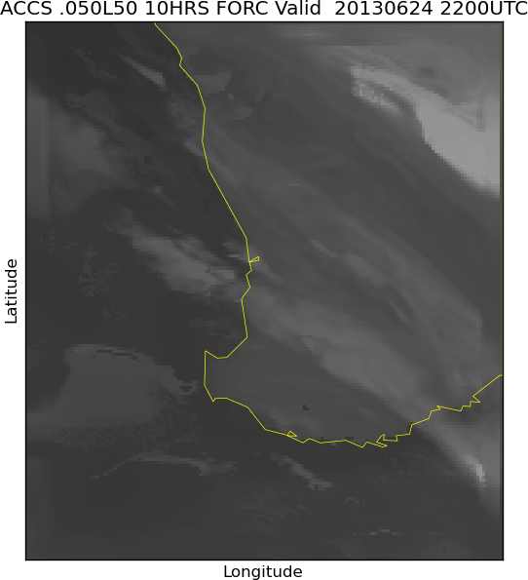
Regional models
ACCESS-PH

Slide 7
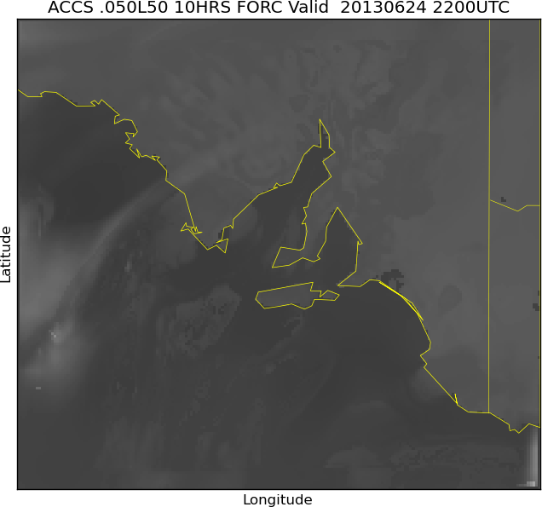
Regional models
ACCESS-AD

Slide 8
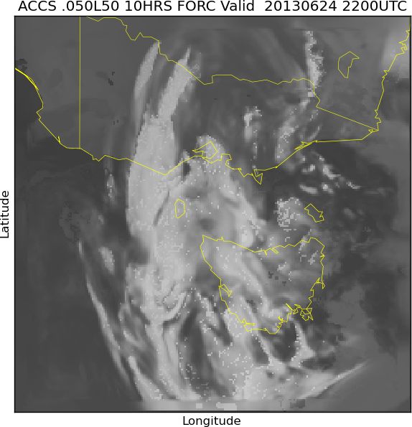
Regional models
ACCESS-VT

Slide 9
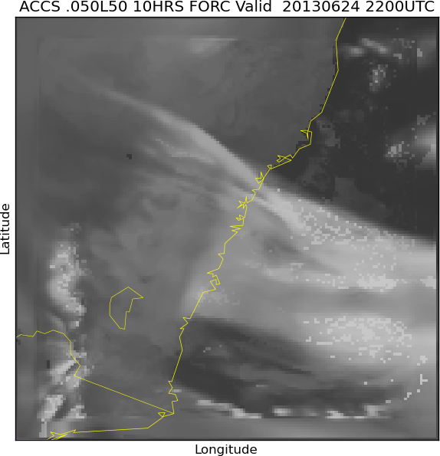
Regional models
ACCESS-SY

Slide 10
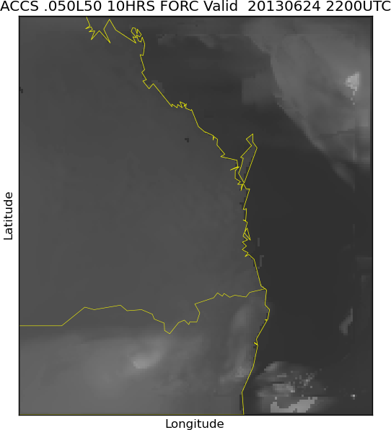
Regional models
ACCESS-BN

Slide 11
How can we compare the model and satellite data?
Standard model field statistical comparisons
RMS, Bias etc
Requires regrid/projection
Value distribution analysis
Histogram comparisons
Image quality metrics
Texture, pyramid scale comparisons
Object based analysis
Cloud features, frontal positions
Displacement vectors

Slide 12
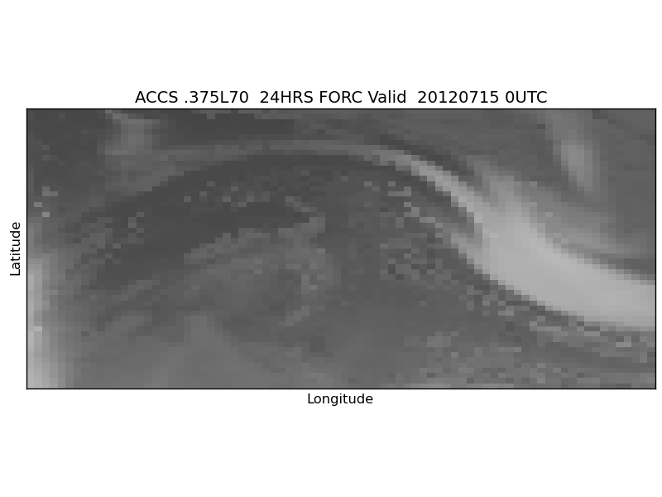
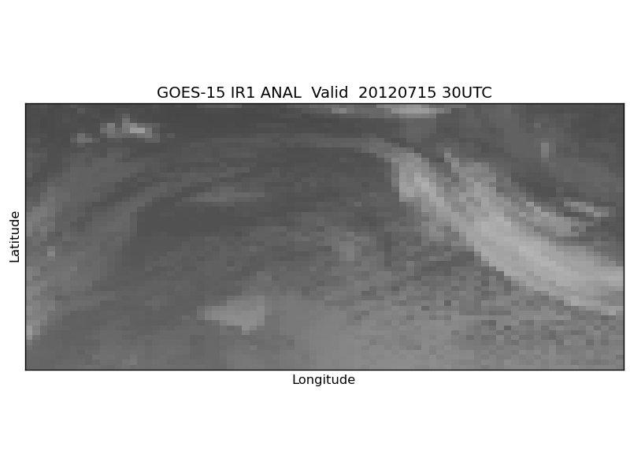
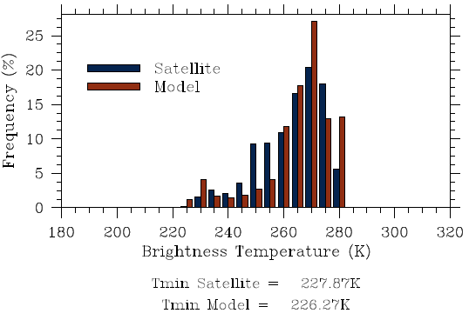
Access-G BT (40S-60S,130W-175W) 24 hour forecast
GOES-15 IR1 at 20120715 00:30UTC
Notes:
12

Slide 13
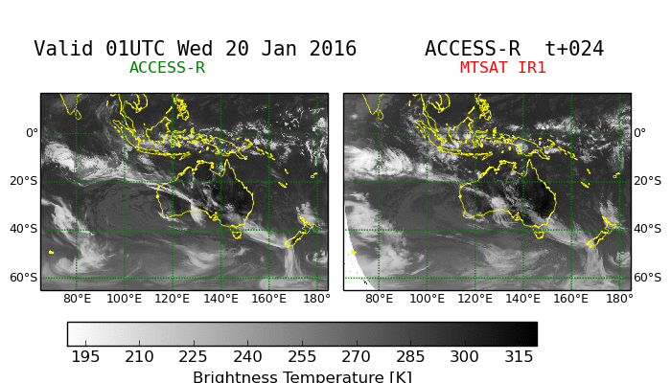
A Direct comparison

Slide 14
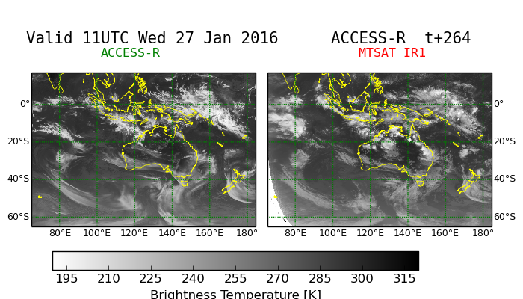
Qualitative assessment
Tropics
Noisier
Too much cold cloud
Pass the squint test
Whoops!
Mid-latitudes
Smoother
Large-scales good
BT range good
Low cloud pretty good

Slide 15
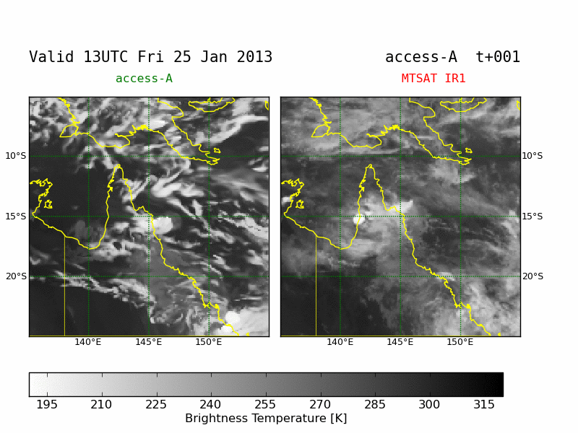
Zooming in on a problem area
Highlights problems with convective parameterization and its link to cloud fields.
Discrete time step character
Oscillations in time
Independent point profiles
Meso-scale structure not explicit
Coupling to large scale cloud problematic

Slide 16
The promise of Himawari 8
Higher time frequency is closer to model time step
ACCESS-C models are close to same spatial resolution
More channels mean more information to match
GEOCAT products give satellite-to-model viewpoint
Can we use the data to directly validate the cloud budget equations?
The differences between cloud position and consequent rainfall gives indirect information on microphysics
10 minute intervals allow us to watch clouds evolving

Slide 17
Lawrie Rikus
Earth Systems Modelling
Research and Development
Phone: 03 9669 4452
Email: l.rikus@bom.gov.au
Web: www.bom.gov.au
Thank you
Notes:
17

